Slide 1
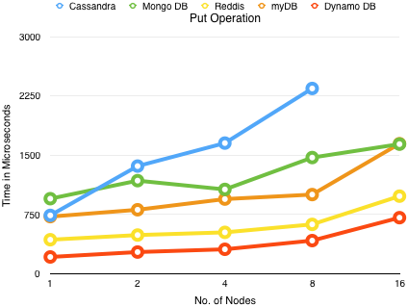
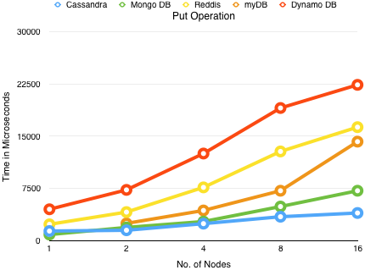
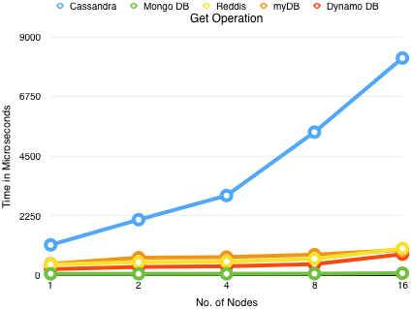
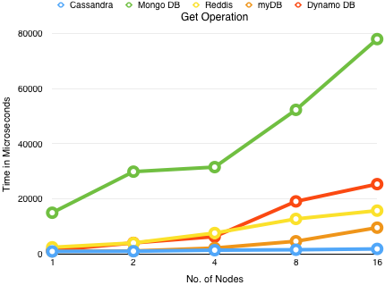
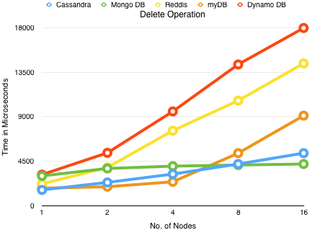
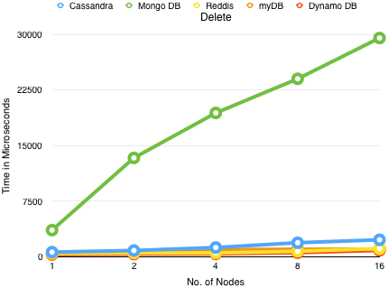



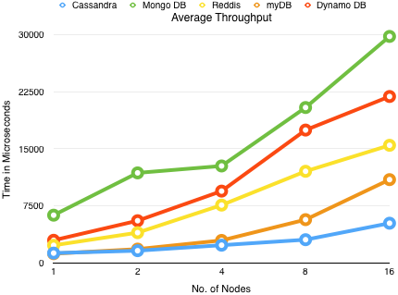

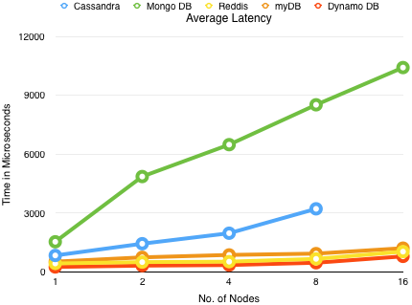
Performance Evaluation of Different Distributed Databases Unnikrishnan Sasikumar, A20345030 Department of Computer Science Illinois Institute of Technology
￼
ABSTRACT
The Database myDB that we have used here to compare with other commercial grade Databases is an implementation of a Distributed Hash Table system and it mainly makes use of a Hashing Function to calculate a random value within a range. Separate Copies of data value pairs will be stored or distributed across Peers or Clients. The Value obtained from this Hashing Function will be used to determine the Peer where the Data will be present and connection is made to that Peer to get the value of the data stored .This Application mainly does 3 operations : storing a key/value pair, get value from a key and delete a key value entry. Performance Evaluation here is done on an Amazon AWS Cluster of 16 M3 nodes Instances. Performance Comparison was mainly done for basic operations such as Get, Put and Delete operations.
Latency Evaluation
Throughput Evaluation
CONCLUSIONS
Performance Evaluation was successfully done for 5 commercial grade Databases on Amazon AWS Medium Cluster with each instance of the Database running on each of the 16 nodes in the cluster. We successfully managed to gauge the performance of different databases with respect to their latency and throughput. Looking at the graphs we get to know which Distributed Database System performs well under different load conditions. Database Systems that are seen to have lower Latency on the Left Side tend to have higher throughput as seen on the right hand side. As seen from the graphs myDB was seen to perform well compared with other commercial grade platforms , although this may not be the case as we scale up. As the other commercial grade Databases have inbuilt proprietary systems that are specifically built for handling huge loads.
Main Concepts
Evaluation was done mainly on Amazon AWS M3 Cluster for 2 parameters mainly Latency and Throughput
Latency is defined as the time taken for Data Packets to reach the end Point or Destination. In this Context we mainly look at the average Time for each Operation (Get/Put/Delete) to take place.
Throughput is the Number of Operations that could be carried out per second.
The Database Systems that where used for evaluation are :
Cassandra Database
Mongo DB
Reddis
Dynamo DB
myDB -- Custom
References
Amazon AWS EC2 - https://aws.amazon.com/ec2/
Cassandra Documentation - http://wiki.apache.org/cassandra/GettingStarted
Mongo DB tutorial - https://www.mongodb.com/mongodb-architecture
Reddis Documentation - http://redis.io/documentation
Dynamo DB tutorial - https://aws.amazon.com/dynamodb/
For additional information please contact:
Unnikrishnan Sasikumar
Department of Computer Science
Illinois Institute of Technology
usasikum@hawk.iit.edu

